Slide 1
Module XV
In-plant accident management
Case Studies
Ferenc Adorján
HAEA (retired)
ferencadorjan@gmail.com

Slide 2
INTRODUCTION
Students should be divided into groups;
  For international course it is preferred to form mixed groups.
Each group should spend 2 – 3 hours discussing the cases and prepare a short presentation for the plenary session.
Lecturer should decide if each group works on all cases or each group is assigned one case.

Slide 3
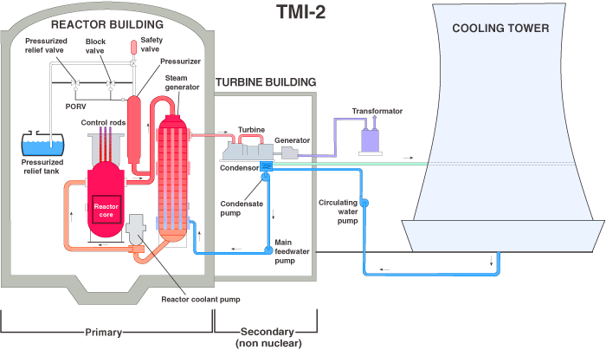
Case 1 – TMI accident

Slide 4
Case 1 – TMI accident
Beginning of an accident (March 28, 1979):
  Main feedwater pump fails to send water to steam generators;
  Plant's turbine-generator and then the reactor automatically shut down;
  Pressure in the primary system (the nuclear portion of the plant) began to increase;
  To control that pressure, the pilot-operated relief valve (a valve located at the top of the pressurizer) opened;
  Valve should have closed when the pressure fell to proper levels, but it became stuck open;
  Instruments in the control room indicated to the plant staff that the valve was closed;
  Cooling water was pouring out of the stuck-open valve.

Slide 5
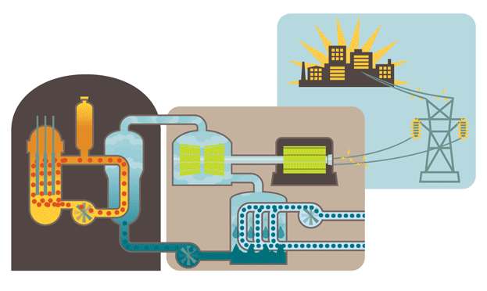
Case 1 – TMI accident
Notes:
Animated diagram of an TMI accident.

Slide 6
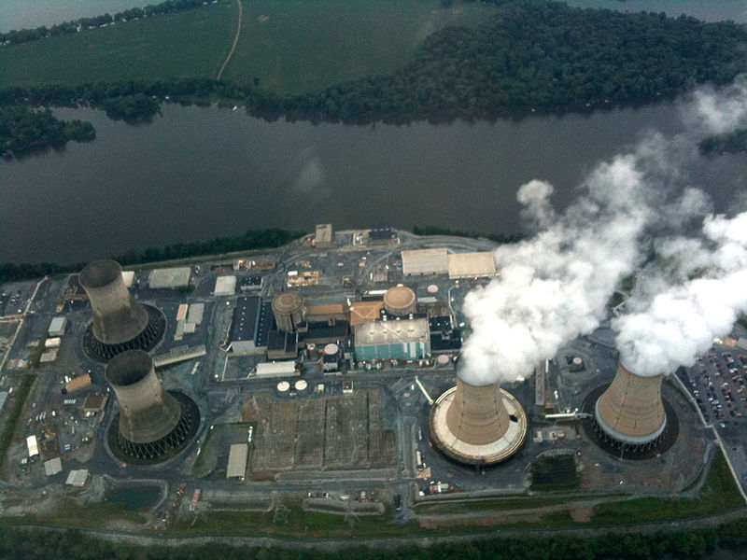
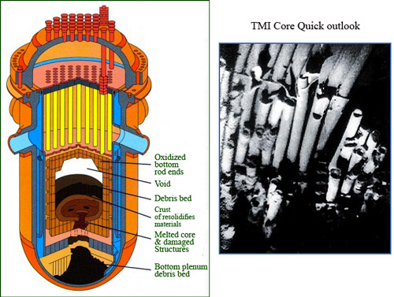
Case 1 – TMI accident

Slide 7
Case 1 – TMI accident
Each group should:
  Identify the initiating event of an accident.
  Describe events following the loss of cooling water (including in-vessel and ex-vessel).
  Describe the source term release phases times and quantities during each phase.
  Which of accident management guidance (EOP and SAMG) is supposed to be used in different stages of accident.
  Which EOP approach should be used.
  Discuss how could accident be prevented and mitigated.

Slide 8
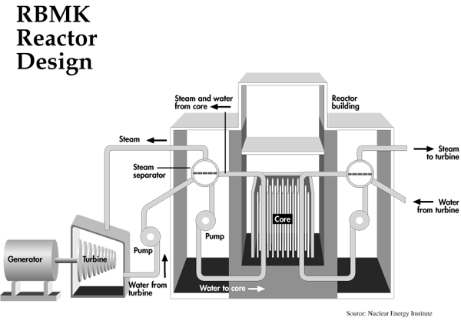
Case 2 - Chernobyl Accident

Slide 9
Case 2 - Chernobyl Accident
Beginning of the accident:
  Operating personnel were conducting unauthorized tests at 7% power to determine coast-down ability of turbine to provide power if the steam supply should be lost to the turbine;
    Not only were the test procedures faulty but the operators even violated portions of the procedures.
  Power level was dropped to 50% and allowed to stay there for ≈ 10 hrs due to grid demands;
    In the meantime, the Xe-135 concentration built-up to the point that the control rods were withdrawn even more to compensate for this.
  Emergency core cooling system (ECCS) was disconnected for the test;
  Reactor temperature/pressure was near saturation, coolant flow too high, rods withdrawn too far, feedwater supply overbalanced;
  Initiating event was closure of the emergency stop valve to the turbine;

Slide 10
Case 2 - Chernobyl Accident
  Flow reduction resulted in increased boiling in the core;
  Increased steam production caused positive reactivity feedback;
  Took about 2 sec for the reactor to go prompt critical, this first power/reactivity maximum was stopped by the Doppler effect;
  Second peak (≈ 4500% full power) was created by the lack of coolant flow; Doppler effect was of little help; reactor went superprompt critical again with the reaction being stopped by the fuel disintegration;
  Pipes above the reactor were burst and the reactor building roof blown; steam explosion severely damaged the ECCS pipes above the core;
  Water removal did not result in moderator removal as in a U.S. light-water reactor (LWR) so there was no shutdown due to the loss of coolant;
  Water boiling away resulted in a reactivity increase (no absorber); thus reactor has a positive reactivity coefficient for loss of coolant (opposite of that for a LWR);

Slide 11
Case 2 - Chernobyl Accident
  Reactor was on a super prompt critical excursion and went from 10% power to 4500% power over about 6 sec;
  Fuel cladding reacted with the steam to form hydrogen;
  Hydrogen caused a secondary explosion whose energy release set the graphite core on fire;
  Very severe graphite fire ensued;
  This fire allowed radioactive particles to be carried away in a radioactive plume high into the atmosphere;
  Chernobyl had no containment building as in the U.S. so radioactivity easily escapes;
  Operators had turned off 7 sets of emergency systems, any one of which could have prevented the accident;
  Reaction stopped by dumping 5,000 tons of boron-carbide, limestone and lead into the top of the reactor by helicopter.

Slide 12
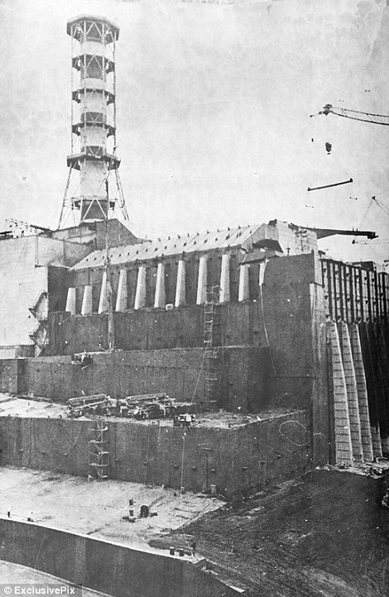
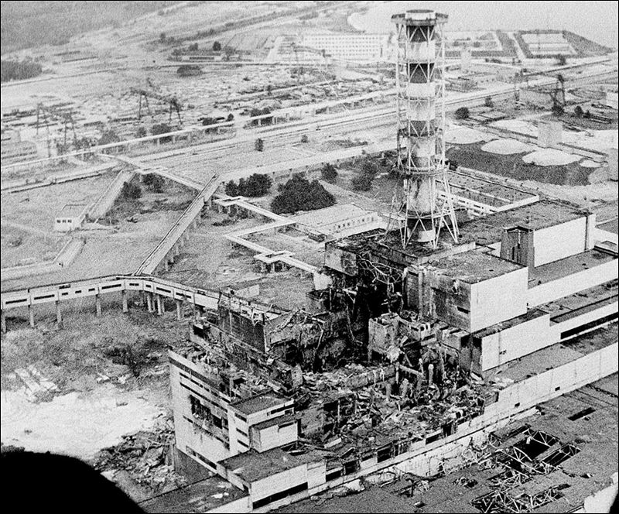
Case 2 - Chernobyl Accident

Slide 13
Case 2 - Chernobyl Accident
Each group should:
  Identify the initiating event of an accident.
  Describe events following excursion of power from 10% to 4500% (including in-vessel and ex-vessel).
  Describe the fission product (source term) release phases times and quantities during each phase.
  Which of accident management guidance (EOP and SAMG) is supposed to be used in different stages of accident.
  Discuss how could be accident prevented and mitigated.

Slide 14
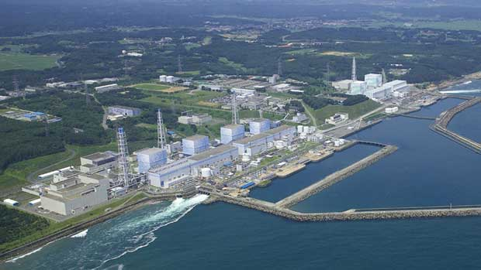
Case 3 - Fukushima Daiichi Accident

Slide 15
Case 3 - Fukushima Daiichi Accident
Beginning of the accident; 11 March.
  9.0 magnitude earthquake strikes off the coast of Honshu Island. The Fukushima I power plant's nuclear reactors 1, 2, and 3 are automatically shut down by the tremor. Nuclear reactors 4, 5, and 6 were undergoing routine maintenance and were not operating.
  The tremor has the additional effect of causing the power plant to be cut off from the Japanese electricity grid, however, backup diesel generators kick in to continue cooling.
  Reactor 1's emergency cooling system, which is capable of running without external power, turns on automatically. Reactor 1's emergency cooling system is manually shut down.
  The first tsunami strikes the plant.

Slide 16
Case 3 - Fukushima Daiichi Accident
  The emergency condenser designed to cool the steam inside the pressure vessel of the No. 1 reactor fails.
  14-metre tsunami overtops the seawall designed to protect the plant, inundating the Fukushima facility and disabling the backup diesel generators and washing away their fuel tanks.
    With the loss of all electrical power supply, the low-pressure core spray, the residual heat removal and low-pressure coolant injection system main pumps, and the automatic depressurization systems all failed (most of the emergency core cooling system). Only the steam-powered pump systems (isolation condenser in reactor 1, high-pressure coolant injection and reactor core isolation cooling system in reactors 2 and 3) remained available.
  The falling water level in reactor 1 reaches the top of the fuel, and the core temperature starts climbing.
  Reactor 1's emergency cooling system is once again back on.
  The fuel in reactor 1 becomes fully exposed above the water surface, and fuel damage in the central core begins soon after.

Slide 17
Case 3 - Fukushima Daiichi Accident
12 March;
  Emergency battery power for the high pressure core-flooder system (HPCFS) for reactor 3 runs out.
  Fuel rods in reactor 3 are exposed.
  Despite the high risk of hydrogen (produced from the water in the containment vessel) igniting after combining with oxygen from water or in the atmosphere, and in order to release some of the pressure inside the reactor at Fukushima I unit 1, the decision is taken to vent some of the steam (which contained a small amount of radioactive material) into the air.
  Fresh water injection into reactor 1 is started.
  Although unknown at the time, the core of reactor 1 has now completely melted and falls to the bottom of the reactor pressure vessel.

Slide 18
Case 3 - Fukushima Daiichi Accident
  Pressure still remains too high inside reactor unit 2 at Fukushima I. In order to alleviate some of this pressure, a consensus is reached to once more vent radioactive vapour into the air.
  There is a massive explosion in the outer structure of unit 1. The concrete building surrounding the steel reactor vessel collapses as a result of the explosion.
  To release pressure within reactor unit 1 at Fukushima I, steam is released out of the unit into the air. This steam contains water vapour, hydrogen, oxygen and some radioactive material, mostly tritium and nitrogen-16.
13 March;
  The high pressure coolant injection system for reactor 3 stops and, shortly thereafter, the water level within the reactor starts falling.
  Fukushima I Unit 1 is declared as an INES Level-4 "accident with local consequences" event.

Slide 19
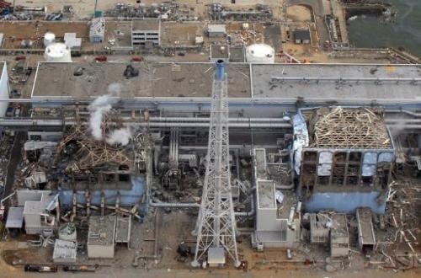
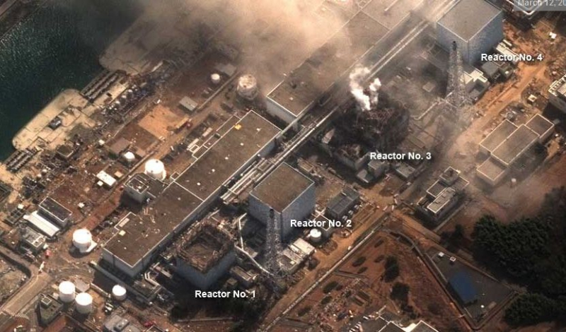
Case 3 - Fukushima Daiichi Accident

Slide 20
Case 3 - Fukushima Daiichi Accident
Each group should:
  Identify the initiating event of an accident.
  Which of accident management guidance (EOP and SAMG) is supposed to be used in different stages of accident.
  Which EOP approach should be used.
  Discuss the curse of events.
  Discuss how could be accident prevented and mitigated.
  Discuss how could be maintained long-term safety stable state.

Slide 21
GROUP PRESENTATIONS
21
1 – 2 hours should be devoted to group presentations and discussions.
Each presenting group should prepare a set of slides.
At presentation each presenting group should argument each of their statements.
At the end of all presentations the lecturer should lead a discussion to compare all 3 cases.
The views expressed in this document do not necessarily reflect the views of the European Commission.

Slide 22
Use this box for any additional message
Thank you!
Notes:
Thank you!

